Slide 1

HCC NE P-16 Partners Meeting
September 22, 2022: 9:00 a.m. – 10:30 a.m.
The mission of the Houston Community College Dual Credit Program is to provide high school students a seamless pathway into post-secondary education by providing courses aligned with academic or workforce degrees and/or certificates, while being the higher education institution of choice for public, private, and charter high school partners.

Slide 2
HCC DC Program Strategic Plan
Access: P-16 provides an entry point into higher education by providing access to educational resources thus leading to opportunities to obtain college credit.
Equality: P-16 is committed to bridging the gap of limitations to include equal opportunities for all students.
Engagement: P-16 empowers students to take an active role in their education by linking them to resources and student services to engage students in the learning process.
Success: P-16 values the commitment of fully supporting students as they transition into future career and college endeavors having a lifelong impact.

Slide 3
HCC DC Program Strategic Goals
Provide college access to high school students by providing them with a seamless pathway to post-secondary education;
Provide courses that allow high school students to begin their post-secondary education and prepare students for high-skill employment in high-demand workforce occupations through advanced, rigorous coursework;
Prepare students to reach college readiness standards; and
Become the preferred institution of higher education partner for secondary education.

Slide 4

AGENDA TOPICS
Introductions
Fall Dual Credit Data
Puente Program
College Services
Faculty Qualifications
Spring Enrollment
Open Discussions
Question and Answers
North Forest Tour

Slide 5
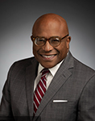
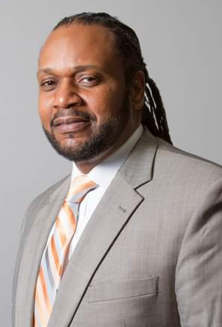
WELCOME
9:00 a.m. – 9:10 a.m. | Houston Community College Northeast: Reginald G. Peters – Director, College P-16
Welcome Introductions
Michael Edwards, JD.
President, HCC Northeast
Desmond Lewis, Ed.D.
Associate Vice Chancellor, College Readiness

Slide 6
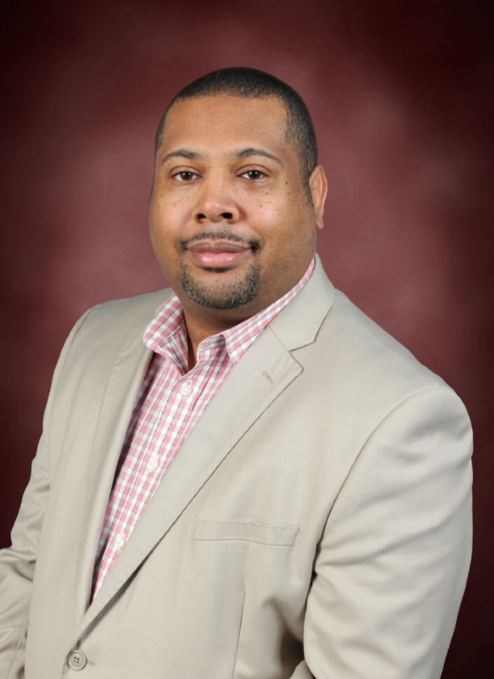
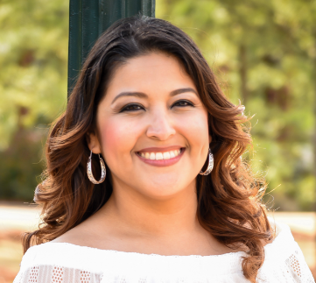
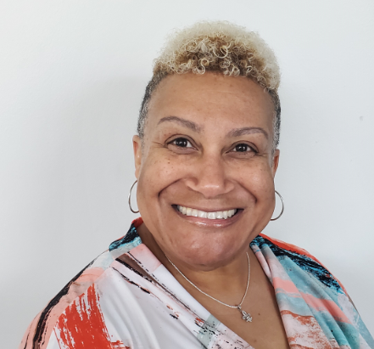
WELCOME
9:00 a.m. – 9:10 a.m. | Houston Community College Northeast: Reginald G. Peters – Director, College P-16
Reginald G. Peters – Director, P-16 Sandra Herrera – Success Coach, P-16 Katina Rise – Administrative Assistant, P-16

Slide 7
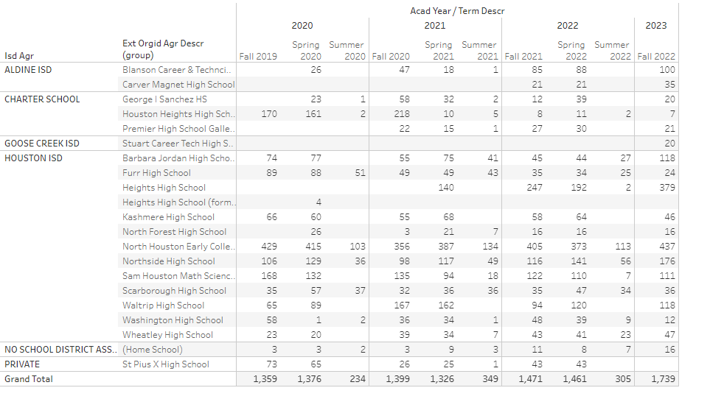
Dual Credit Fall Numbers

Slide 8
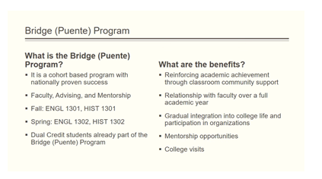
Puente Program
9:10 a.m. – 9:20 a.m. | Houston Community College: Syble Davis – Co-Coordinator, Bridge (Puente) Program

Slide 9
College Services
9:20 a.m. – 9:25 a.m. | Houston Community College Northeast: Reginald G. Peters – Director P-16
College Services Request: We are ready to meet with you to ensure that your students have an outstanding Dual Credit Experience If you would like to request the following activities at your high school, please complete the College Services Request form in SmartSheet. Application Workshops Campus Tours Dual Credit Orientations Dual Credit Overviews Library Presentation Senior Transition (High School to College) ALL SPRING PAPEWORK DUE FRIDAY, NOVEMBER 4th

Slide 10
Add/Drop/Swap
9:25 a.m. – 9:30 a.m. | Houston Community College Northeast: Reginald G. Peters – Director P-16
Adding a Class The student was not previously enrolled in the class – the student needs to be added to the class roster Dropping a Class The student is currently enrolled in the class – the student needs to be removed from the class roster Swapping A Class The student is currently enrolled in one class section and needs to get into another section. When you’re switching from one class into another, do not drop a class and add another. Switch classes using the SWAP tab. This guarantees that there are no time conflicts when enrollment swaps from one class to the other

Slide 11
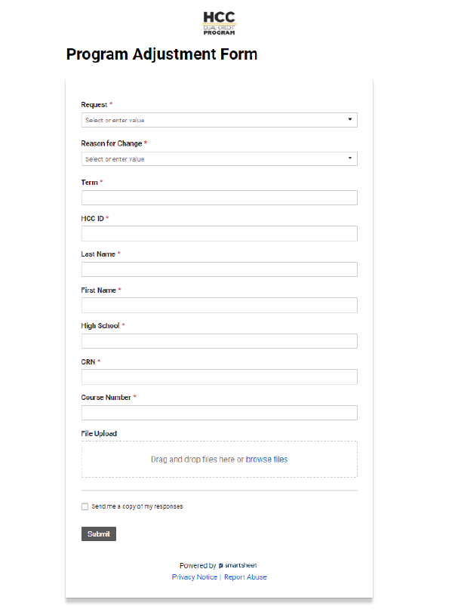
Program Adjustment Form
9:25 a.m. – 9:30 a.m. | Houston Community College Northeast: Reginald G. Peters – Director P-16
Complete this form in Smartsheet if a student would like to drop a course or if the student withdraws from the high school. If you do not hear from the NE P-16 Team within 48 hours acknowledging your submission, please follow-up with the NE P-16 Team. Submit forms 48 hours prior to the official college W deadline to allow time for processing. Do not wait until the last day to drop or withdraw a student. Allow the enrollment office 48 hours to process all requests

Slide 12
Faculty Qualifications
9:30 a.m. – 9:35 a.m. | Houston Community College Northeast: Reginald G. Peters – Director P-16
The Southern Association of Colleges and Schools Commission on Colleges (SACSCOC) and the Texas Higher Education Coordinating Board establish standards to which the College adheres regarding the minimum academic credential for all members of the faculty, both full-time and adjunct. Most academic faculty must have earned and can document receipt of a master’s degree with at least 18 graduate hours in the teaching specialty. Qualifications for teaching occupational/technical courses require at least three years of related work experience and an associate’s degree in the teaching field are required. Who does not qualify: Masters of Arts in Education/Teaching without 18 graduate hours in their teaching specialty Doctor in Education and Administration without 18 graduate hours in their teaching specialty Someone who is “about to graduate”

Slide 13
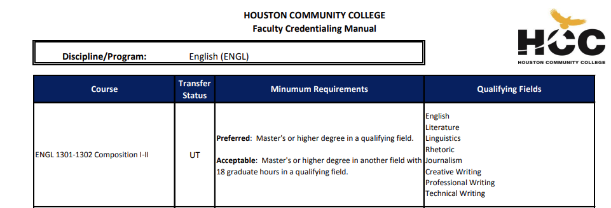
Faculty Qualifications
9:30 a.m. – 9:35 a.m. | Houston Community College Northeast: Reginald G. Peters – Director P-16
If you have an embedded instructor of interest and you would like to get a preliminary approval, please complete the DC Embedded Instructor Request in Smartsheet. If you would like the document to the HCC Faculty Discipline/Program Credentialing Standards for Academic and Workforce Program Credentialing Standards, I can send those to you: OCTOBER 1st – Please communicate if you have potential instructors for the spring MARCH 1st is District Deadline for prospective instructor online application

Slide 14
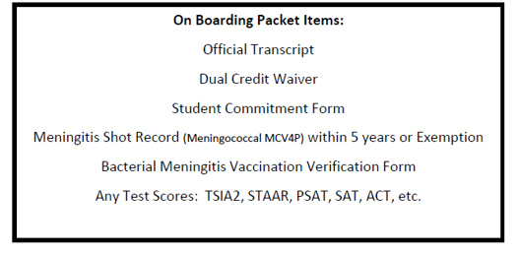
OnBoarding Packet
9:35 a.m. – 9:45 a.m. | Houston Community College Northeast: Reginald G. Peters – Director P-16
A meningitis exemption is valid for only 2 years A meningitis record is valid for 5 years

Slide 15
High School Transcripts
9:35 a.m. – 9:45 a.m. | Houston Community College Northeast: Reginald G. Peters – Director P-16
High School Official Transcripts will need the following:
  Must state Official
  Official Signature
  GPA

Slide 16
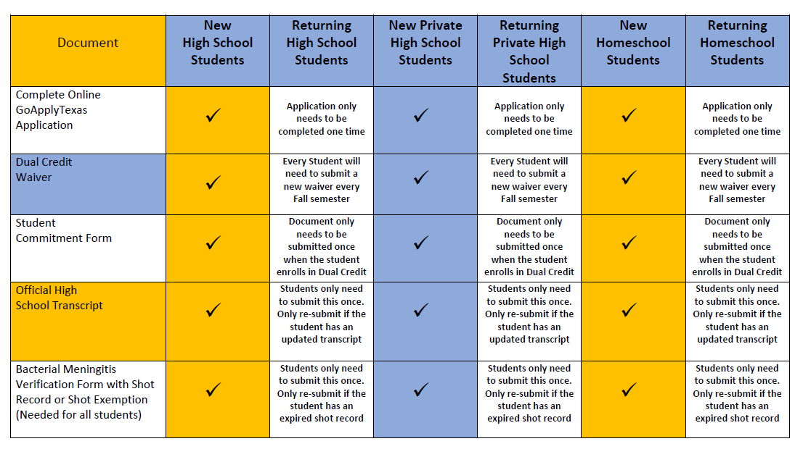
Required Documents
9:35 a.m. – 9:45 a.m. | Houston Community College Northeast: Reginald G. Peters – Director P-16

Slide 17
Registration and Enrollment Management
9:35 a.m. – 9:45 a.m. | Houston Community College Northeast: Reginald G. Peters – Director P-16
If a student’s GPA has dropped below a 2.0, please have them check in the student center to sign-up for a SLIP session. Student’s with a GPA of less than 2.0 need to reconsider if Dual Credit is the best option for them. RE-ADMIT: If a student has not participated in Dual Credit for 3 semester, they need to re-apply Students should always choose one of the following paths. Undeclared is not an option: Associate of Applied Science Associate in Arts Associate in Science Level I Certificate Level II Certificate

Slide 18
Course Schedule
9:45 a.m. – 9:55 a.m. | Houston Community College Northeast: Reginald G. Peters – Director P-16
All Course Schedules will be submitted through Smartsheet: When requesting a course, the course needed MUST have the correct contact hours Class requests must contain all necessary information in their meeting pattern when submitted Contact hours must be real-time hours of class lecture and/or discussion time of the class with the instructor during the scheduled meeting pattern. Contact hours will not be replaced with after-school class work or tutorial sessions Meeting patterns will not be altered after a class is created All classes must be either in-person or online on a schedule (WS) (MATH DEPARTMENT) For HCC Support/HCC Faculty Submit a completed roster with proposed times by October 15 48 Contact Hours need to be scheduled for 48 contact hours, not more Try for M/W or T/TR Schedule Friday for one class is not feasible Be cautious about canceling an entire class with HCC Support/HCC Faculty in the final hour Please complete all Spring 2023 Course schedules by October 15

Slide 19
Course Requests
9:45 a.m. – 9:55 a.m. | Houston Community College Northeast: Reginald G. Peters – Director P-16
Subject: EDUC Catalog: 1300 Course Name: Learning Framework Room Type: LEC, LAB, LEC/LAB (choose 1) Session: DL1, DL2, RT, SS, 8W1, 8W2 (choose 1) Campus: NE Location: DUAL78 Mode: HY (Hybrid), P (In Person), WS (Online on a schedule), WW (Online anytime) – {choose 1} Days: Put an X in each column of the week the class will be held Start Time: Enter the time the class will start End Time: Enter the time the class will end Instructor Name: Enter the name of the instructor that will be teaching the class. If you need someone from HCC to teach the class, enter HCC Support. Assign Type: If the faculty is an embedded instructor choose embedded. If it is an HCC Faculty and you are requesting HCC Support, choose HCC Faculty. Class Notes: This section is for any comments by the requestor. Comments: This section is for any comments made by Dr. Scott Godley (HISD Only)

Slide 20
SmartSheet
9:45 a.m. – 9:55 a.m. | Houston Community College Northeast: Reginald G. Peters – Director P-16
All DC Partners must utilize SmartSheet to ensure an efficient and effective way for all parties to track students: DC Liaisons will need to enter the following information on the students: New/Returning HCC ID Name DOB Term Check your tracking sheet for students that are not participating in dual credit for that semester and remove them. DC Liaisons will need to upload the documents directly to the student’s file (line). Transcript Test Scores Meningitis Requirements Met Standards Boxes (Green Check = Yes, or Red X = No) The items below can be uploaded into a Batch upload in SmartSheet Document Submission. Waiver Form Commitment Form

Slide 21
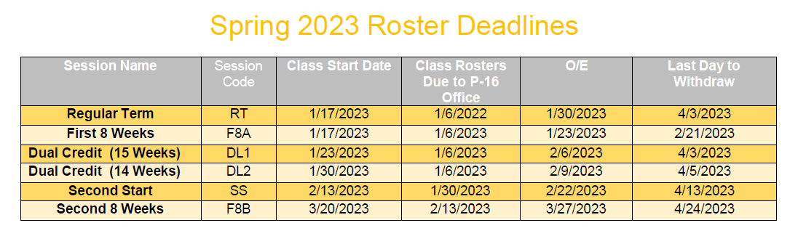
Spring Deadlines
9:55 a.m. – 10:00 a.m. | Houston Community College Northeast: Reginald G. Peters – Director P-16
ALL SPRING PAPEWORK DUE FRIDAY, NOVEMBER 4th Begin to submit Spring Rosters – December 12th

Slide 22
DC Liaison Orientation
October 12th (THIS IS A NEW DATE)
HCC Northline
9:00 a.m. – 11:30 a.m.
Part I
  Understanding Dual Credit
Part II
  Utilizing SmartSheet for all Your Dual Credit Needs

Slide 23


WE ARE HERE TO HELP YOU!
REGINALD G. PETERS
NE College P-16 Director
reginald.peters@hccs.edu
SANDRA HERRERA
NE College P-16 Success Coach
Sandra.herrera@hccs.edu
KATINA RISER
NE College P-16 Administrative Assistant
katina.riser@hccs.edu

Slide 24
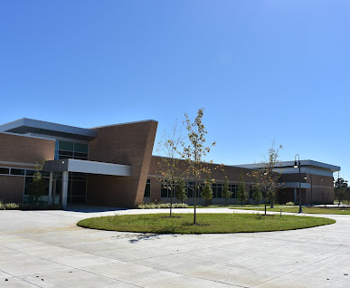
HCC North Forest Tour
Join us for a 30-minute walking tour of our North Forest Campus, led by Mr. Michael Frazier, Please note that some of this tour will consist of walking outside to visit the remodeled Student Services Building and Automotive Center.

